Slide 1


All Standards, All Students
Diversity and Equity
Economically Disadvantaged Students
English Language Learners
Notes:
I am speaking on behalf of:
1. Stephen with vision, trust, and support
2. Diversity and Equity Team
3. Achieve staff
4. Design team
CCSS in ELA and math did not address diversity and equity issues for various reasons.
NGSS is addressing diversity and equity issues from the start, not as an after-thought.
Please speak to your colleagues in ELA and math about how science has addressed diversity and equity issues.

Slide 2

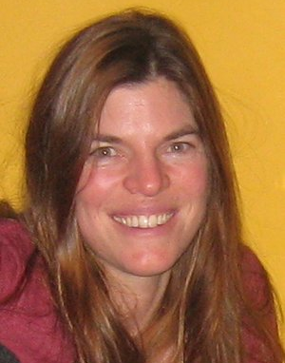


NGSS Diversity and Equity Team
Emily Miller
2nd 3rd Grade
ESL/BRT Teacher
Madison Metropolitan School District
Madison, WI
Rita Januszyk
4th Grade Teacher
Gower District 62
Willowbrook, IL
Okhee Lee
New York University
New York, NY

Slide 3


The Framework Vision
“Arguably, the most pressing challenge facing US. Education is to provide all students with a fair opportunity to learn.”
Notes:
The Framework provided the call for addressing Equity and Diversity

Slide 4

Notes:
How do diverse students respond to NGSS?

Slide 5
Bias Reviews
Diversity and
Equity Topic
in Appendices
Seven
Case
Studies
Appendix D
Economically
Disadvantaged
Students

Slide 6

Each Case Study Includes . . .
Vignette
    NGSS connections
    CCSS ELA and math connections
    Classroom strategies
Research-Based Classroom Strategies
Context
Demographics
Science achievement
Educational policy
Notes:
The case studies are written by the team members in their own classrooms.
Reviewed by the NGSS design team members and outside reviewers

Slide 7
Economically Disadvantaged:
Grade 9 Physical Science
Developing Conceptual Models to Explain Chemical Processes
Racial and Ethnic Groups:
Grade 8 Life science
Constructing Explanations to Compare the Cycle of Matter and the Flow of Energy through Local Ecosystems
Disabilities:
Grade 6 Space Science
Using Models of Space Systems to Describe Patterns
English Language Learners:
Grade 2 Earth Science
Developing and Using Models to Represent Earth’s Surface Systems
Girls:
Grade 3 Engineering
Defining Problems with Multiple Solutions within an Ecosystem
Alternative Education:
Grade 10 & 11 Physical Science
Constructing Explanations about Energy in Chemical Processes
Gifted and Talented:
Grade 4 Life Science
Constructing Arguments about the Interaction of Structure and Function in Plants and Animals
NGSS and CCSS Connections

Slide 8

Science and Engineering Practices and
Crosscutting Concepts
Engineering creates relevance to students
Practices engage students in sense-making
Practices provide opportunities for sophisticated language functions
CCC make connections among big ideas
Notes:
High academic rigor through the NGSS for all students, including ELLs
Both language demands and learning opportunities through the NGSS for all students, including ELLs
A new set of teachers’ knowledge and practices to enable all students, particularly ELLs, learn science according to the NGSS
Focused on a limited number of PE
Should not be viewed as showing all instruction necessary to prepare students to reach PE
PE should not be taught one at a time
Understanding builds over time

Slide 9
Demographic Groups | Student Engagement | Classroom Support Strategies | School Support Systems | Home and Community Connections
Economically Disadvantaged Students | students’ sense of place | project-based learning | school resources and funding | students’ funds of knowledge
Racial and Ethnic Groups | multimodal experiences | multiple representations; culturally relevant pedagogy | role models and mentors | community involvement; culturally relevant pedagogy
Students with Disabilities | accommodations and modifications | differentiated instruction; Universal Design for Learning; Response to Intervention | accommodations and modifications
English Language Learners | discourse practices | language and literacy support | home language support | home culture connections
Girls | relevance; real-world application | curricular focus | school structure | relevance; real-world application
Students in Alternative Education | safe learning environment | individualized academic support | after-school opportunities; career & technology opportunities | family outreach
Gifted and Talented Students | strategic grouping; self–direction opportunities | fast pacing; challenge level

Slide 10
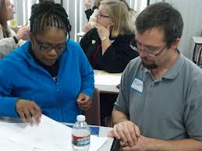
Effective Strategies across Research Areas
  value and respect the experiences that all students bring from their backgrounds (e.g., homes or communities)
  articulate students’ background knowledge (e.g., cultural or linguistic knowledge) with disciplinary knowledge
  offer sufficient school resources to support student learning.
Lee and Buxton (2010)
Notes:
High academic rigor through the NGSS for all students, including ELLs
Both language demands and learning opportunities through the NGSS for all students, including ELLs
A new set of teachers’ knowledge and practices to enable all students, particularly ELLs, learn science according to the NGSS
Focused on a limited number of PE
Should not be viewed as showing all instruction necessary to prepare students to reach PE
PE should not be taught one at a time
Understanding builds over time

Slide 11
Vignette
Economically Disadvantaged Students:
Grade 9 Physical Science
Developing Conceptual Models to Explain Chemical Processes

Slide 12
limited number of performance expectations
understanding builds over time
some topics or ideas require extended revisiting
intended to illustrate a specific context
not prescriptive of science instruction
demographic groups overlap
variability among students within each group
Caveats

Slide 13
Vignette
Blending three dimensions with effective classroom strategies
Disciplinary Core Idea
Science and Engineering Practice
Crosscutting Concept
Effective Strategy

Slide 14
Vignette: Developing Conceptual Models to Explain Chemical Processes
Working in their groups, the class prepared for a simulation of the crushed tanker using an aluminum pop can. The can was filled with a small amount of water, heated to boiling on a hot plate, and then submerged upside down in an ice bath using tongs. The can immediately crushed. The enthusiastic reactions from the students included: “OOO” “It’s cool!” “Awesome, it sucked it in!” (Some comments were based on incomplete understanding.). The teacher asked the students to draw new models by showing the molecules of gas in the can and writing down their ideas in their science journals. (The cultural context of the pop can was an effective use of place to connect to students’ experiences in their community.)
At the end of the two-week unit, Ms. S. challenged the teams to apply their knowledge of thermal energy and pressure to design a tanker that would not implode after cleaning. The design constraints should include use of local materials and a feature that would ensure even poorly trained technicians would not accidentally cause the tanker to implode. Ms. S. led a discussion about how to evaluate the competing design solutions, and the class agreed upon two criteria: cost effectiveness and no implosion. (DCI: ETS1.B: Developing Possible Solutions.) The students were given additional aluminum cans to allow to them to test their ideas. After about 30 minutes of small-group brainstorming, designing, and building, each group had a model to test. (CCC: Structure and Function.) (Practice: Developing and Using Models.)
Performance Expectations
MS-PS1-4 Structure and Properties of Matter
Develop a model that predicts and describes changes in atomic motion, temperature and state of a pure substance when thermal energy is added or removed.
MS-ETS1-2 Engineering Design
Evaluate competing design solutions using a systematic process to determine how well they meet the criteria and constraints of the problem
Classroom Strategy
Blending of Three Dimensions
Bundling of PEs

Slide 15
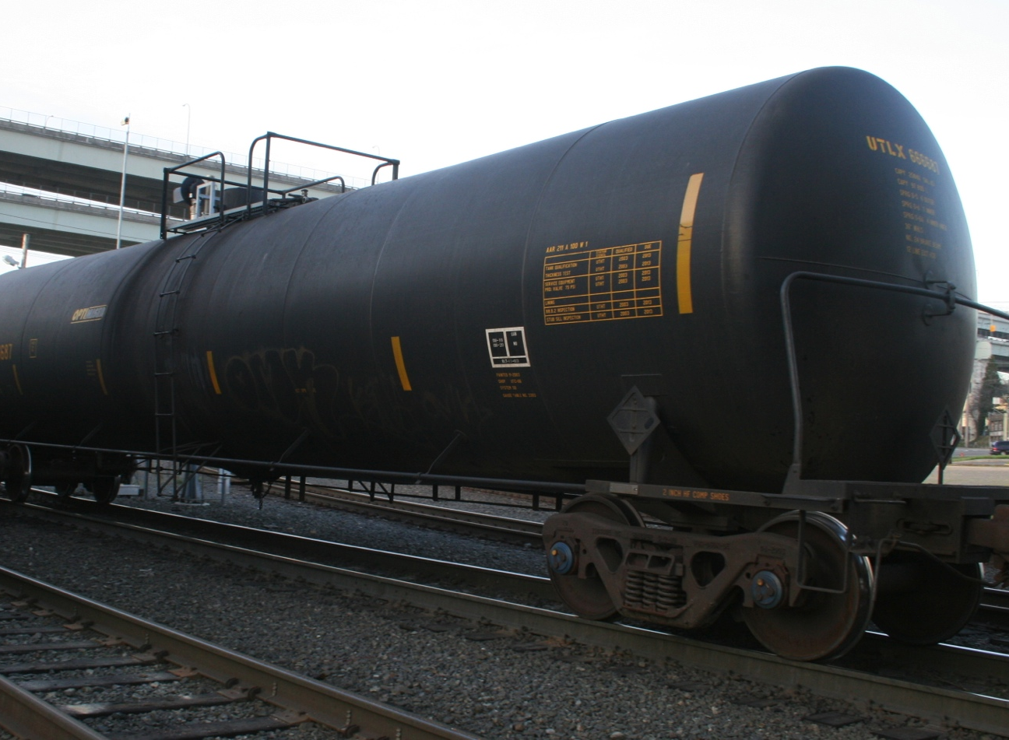
Vignette
Using aluminum pop cans, students tested their evolving ideas about why a railroad tank car collapsed
Notes:
During the 6 week investigation, the students in the vignette engaged in many science and engineering practices. Building a comprehensive understanding of when it means to do science and an understanding of the disciplinary core idea.
Example from the Vignette

Slide 16
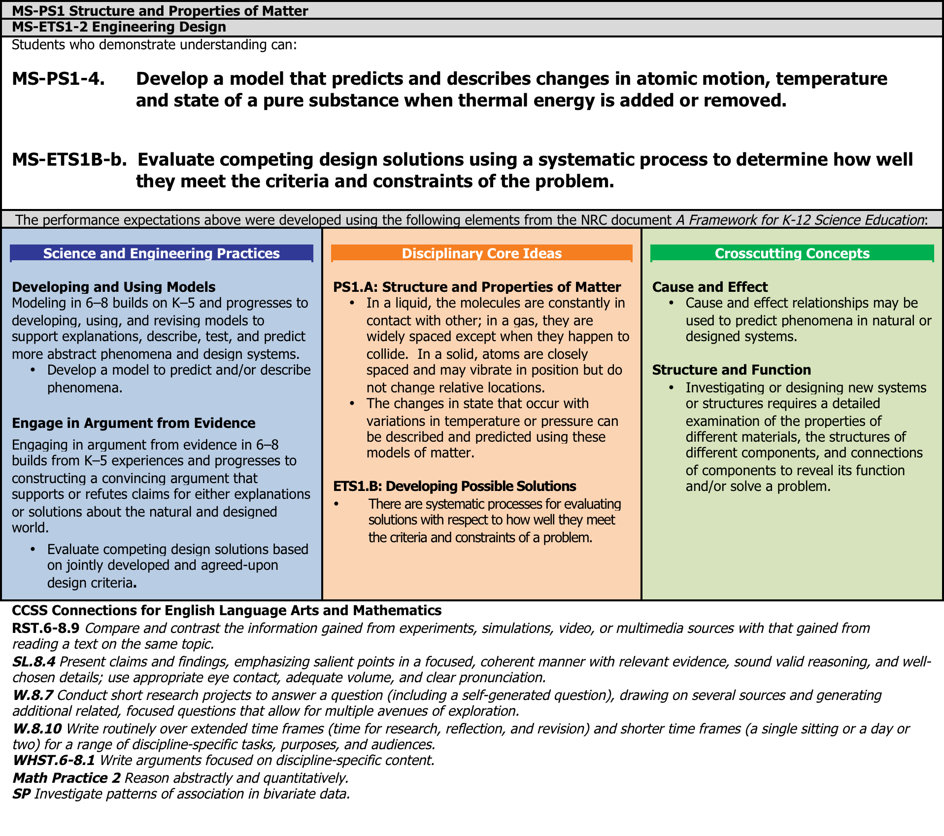
Notes:
The example from the Vignette shows the blending of the dimensions with CCSS.
How do diverse students respond to NGSS?

Slide 17
Vignette
Disciplinary Core Idea
PS1.A Structure and Properties of Matter
Gases and liquids are made of molecules or inert atoms that are moving about relative to each other. The changes of state that occur with variations in temperature or pressure can be described and predicted using these models of matter.

Slide 18
Vignette
Science and Engineering Practice
Developing and Using Models
Use and/or develop models to predict, describe, support explanations, and/or collect data to test ideas about phenomena in natural or designed systems, including those representing inputs and outputs, and those at unobservable scales.
Notes:
The goal of good science learning includes a lot of practices. Several are highlighted in the vignette
Students conceptions about molecular movement are refined as evidence is collected from the pop can investigations. The lessons build upon students’ earlier investigations on gases. The teacher recognizes that some of the student ideas are not developed.

Slide 19
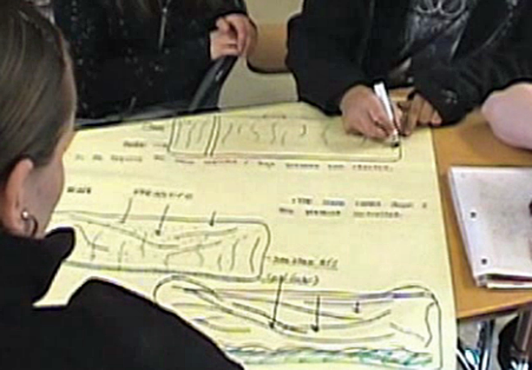
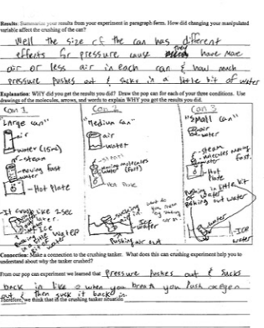
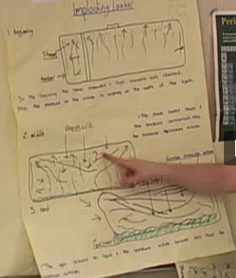
Initial Model
Refined Model
Applied Model
Windschitl, M., Thompson, J., & Braaten, M. Tools for ambitious science teaching, 2008-2013 National Science Foundation, Discovery Research K-12, tools4teachingscience.org
Notes:
Model
Refining
Can model

Slide 20
Vignette
Crosscutting Concept
Cause and Effect
Cause and effect relationships may be used to predict
phenomena in natural or designed systems.
Notes:
Students were finding out the cause of the tank car collapse

Slide 21
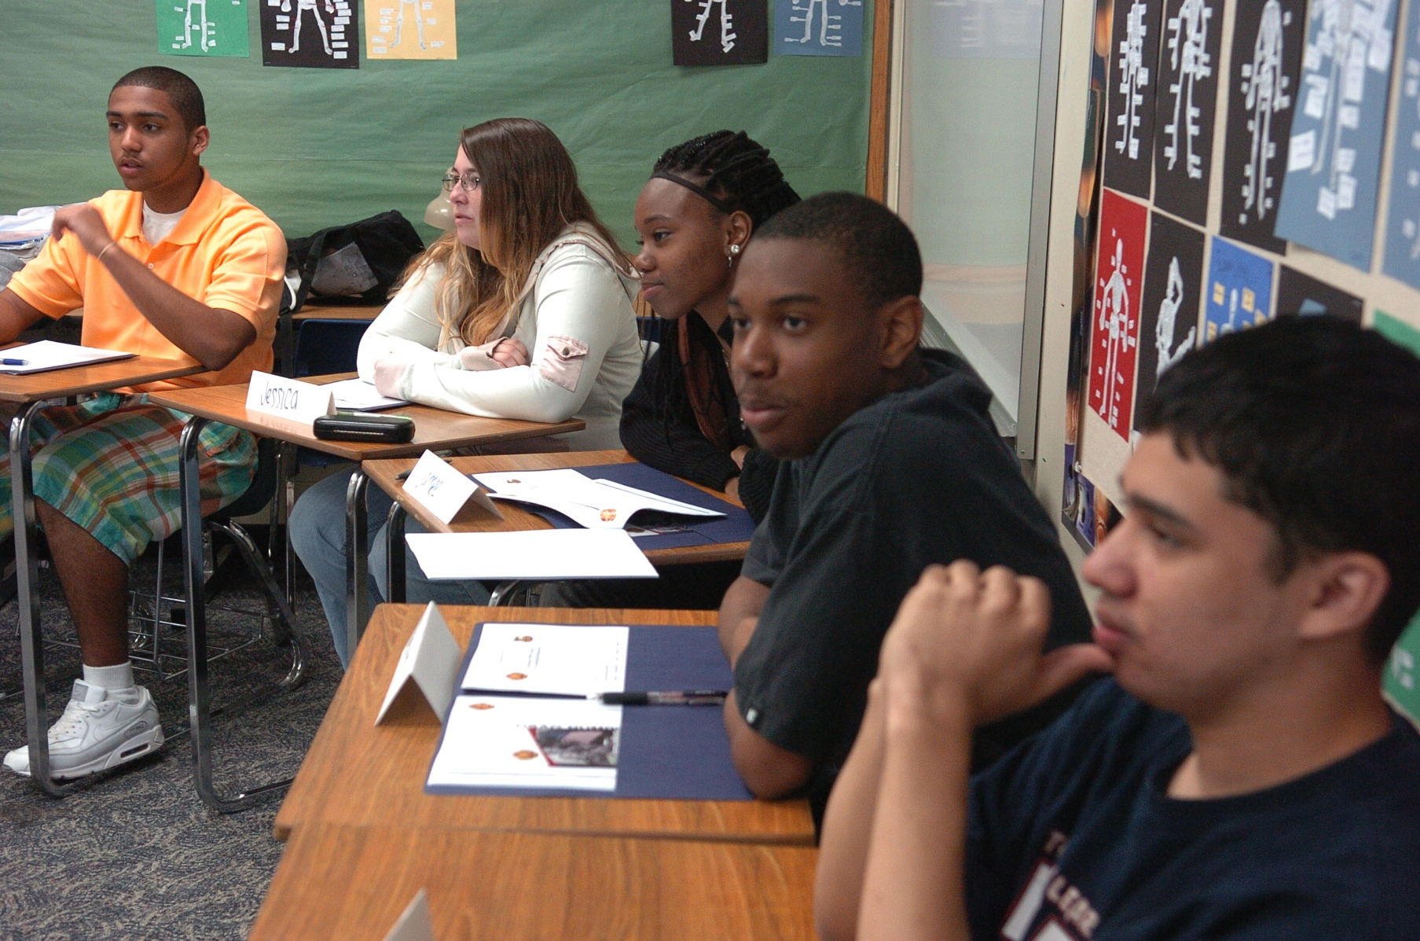
Vignette
CCSS Connections
ELA – reading assignments, synthesizing from range of sources, integrating information from media
Math – reasoning quantitatively, analyzing of data from bivariate data
Notes:
NGSS supports an interdisciplinary approach to science learning in order to provide experiences across disciplines. It is for this reason that each science standard explains its connections to CCSS for ELA and math.
The students in the vignette grappled with core ideas in physical science while meeting CCSS for ELA by discussing, writing and revising explanations and evaluating the scientific arguments presented by others.
Students had reading assignments throughout the unit: pressure and how pressure differential are established.
Students synthesized information from the video of the tanker, their experiments, and the gas pressure vs. temperature simulation.
With the help of the teacher, the students wrote arguments about their models and their learning.
The unit also addressed grade appropriate CCSS for math throughout the exploration with core ideas in physical science. In the vignette the students strove to successfully combine math and science practices to present valid explanations.
Math Practice 2 Reason abstractly and quantitatively.
In the vignette, student models reflected abstract reasoning, using a symbol system including comparisons of relative pressure.
SP Investigate patterns of association in bivariate data.
Students drew the conclusion that as one variable (temperature) increased, the other variable (pressure) increased.
S.IC Make inferences and justify conclusions from sample surveys, experiments, and observational studies.
Students inferred the properties of matter from their observations and experiments and justified their conclusions using the models they created.
We lend the way with the vignette for CCSS practices.
Resolve the science is missed in elementary with CCSS

Slide 22
Classroom Strategies
Demographic Groups | Student Engagement | Classroom Support Strategies | School Support Systems | Home and Community Connections
Economically Disadvantaged Students | Students’ Sense of Place | Project-based Learning | School Resources and Funding | Students’ Funds of Knowledge

Slide 23
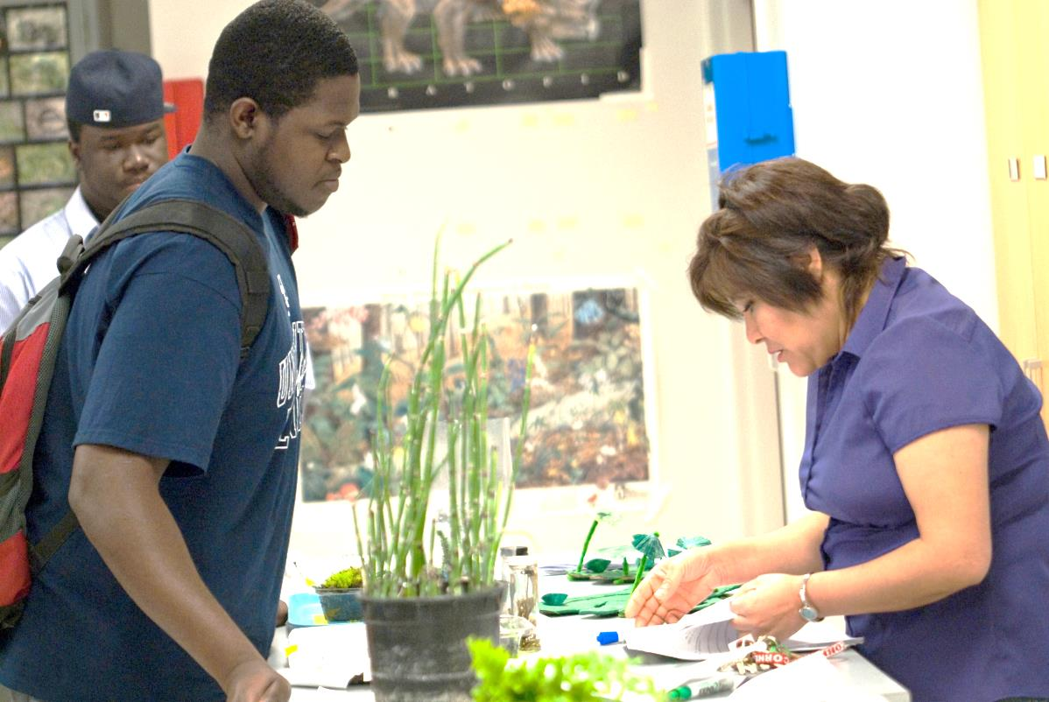
Classroom Strategies
Illustrate how a strategy is integral to lesson design
Not exclusive
Help diverse student groups meet NGSS performance expectations
Are effective for all students

Slide 24
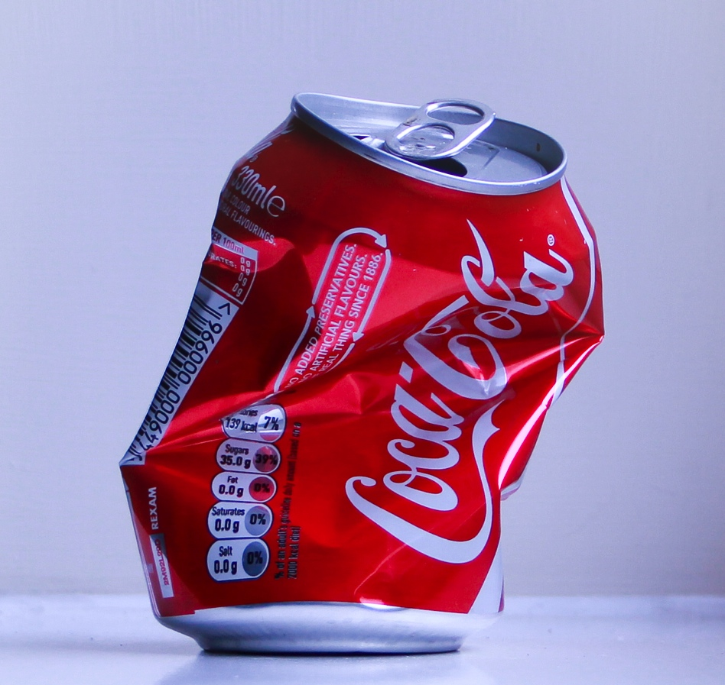
Classroom Strategies
Strategy for Economically Disadvantaged
The teacher validated use of place [smashed cans in the neighborhood] to keep the students engaged and make a connection of science and neighborhood, an effective strategy.

Slide 25
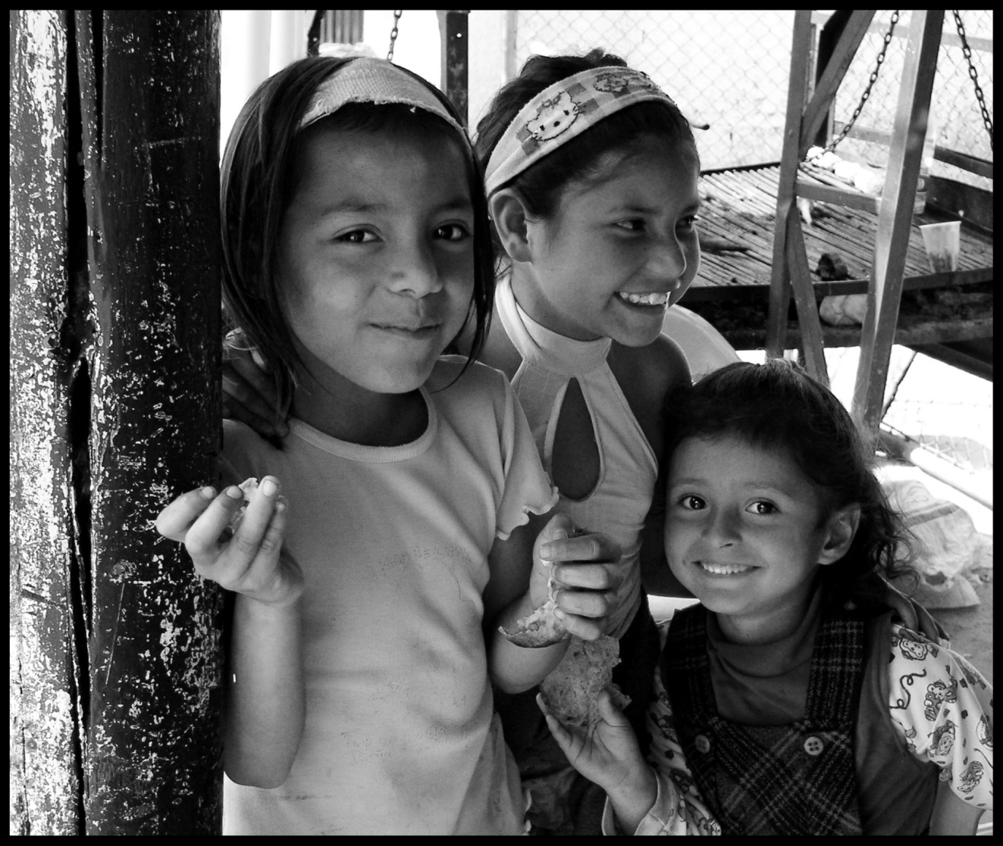
Context
Demographics
Science Achievement
Educational Policy
Notes:
To engage all students in learning the NGSS, it is important to understand the context that influences science learning by diverse student groups. This section briefly describes student demographics, science achievement, and educational policies affecting non-dominant student groups. More details are presented in each of the seven case studies in terms of economically disadvantaged students, racial or ethnic minority students, students with disabilities, English language learners, girls, students in alternative education programs, and gifted and talented students.

Slide 26
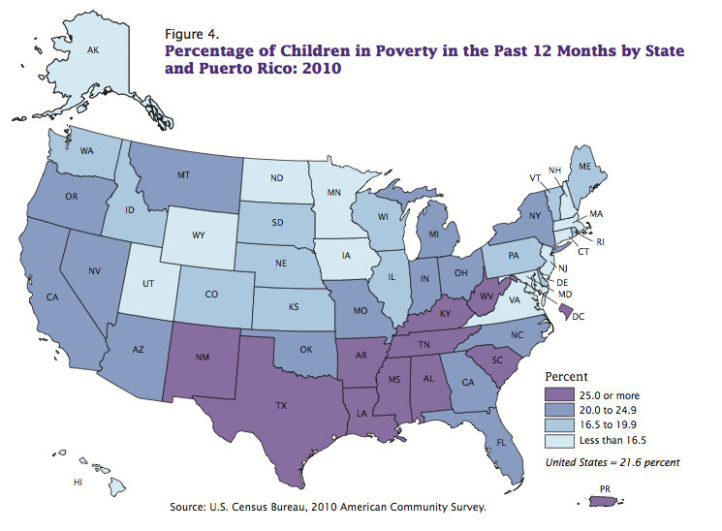
Demographics
Notes:
22% of children live in poverty, the highest rate since the American Community Survey began in 2001 (2010 U.S. Census)
About one in five public schools is considered high poverty in 2011, compared to about one in eight schools in 2000
48% of students are eligible for free or reduced price lunch in 2010
(National Center for Education Statistics.

Slide 27

Demographics
Poverty gaps by race narrowed from 1970 to 2000
Poverty gaps by race have persisted since 2000
      U.S. Census Bureau, Income, Poverty, and Health Insurance Coverage in the United States: 2009, Current Population Reports, series P60-238, and Historical Tables -- Tables 2 and 6, September 2010.
Accessed online at http://www.census.gov/hhes/www/poverty/poverty.html
Notes:
how to make NGSS accessible to all students, thus the title “All Standards, All Students”

Slide 28

Science Achievement Gaps
  National Assessment of Educational Progress (NAEP) in Science
  4th grade
  8th grade
  12th grade
        National Center for Education Statistics. (2011). The nation’s report card: Science 2009. Washington, DC: U.S. Department of Education.
Notes:
National Assessment of Educational Progress (NAEP) collects data on student eligibility for the National School Lunch Program (NSLP) as an indicator of family income. The nation’s report card: Science 2009 looked at science performance for students in grades 4, 8, and 12 (NCES, 2011). In 4th grade, 15% of students who were eligible for free lunch and 25% eligible for reduced price lunch scored at or above proficient in science achievement, compared to 48% of students not eligible who scored at or above proficient. In 8th grade, 12% of students who were eligible for free lunch and 22% of students who were eligible for reduced price lunch scored at or above proficient, compared to 41% not eligible who scored at or above proficient.

Slide 29
164
137
2011
Notes:
The scale at each grade ranges from 0 to 300 with a mean of 150 and standard deviations of 35
FRL is used as the indicator of social class or SES

Slide 30
Educational Policy – Title 1
Provides supplemental funds to school districts in order to assist schools with the highest student concentrations of poverty in meeting educational goals
Purpose: “to ensure that all children have a fair, equal, and significant opportunity to obtain a high-quality education and reach, at a minimum, proficiency on challenging state academic achievement standards and state academic assessments”
Notes:
Title I of the Elementary and Secondary Education Act (ESEA) is the largest federally funded educational program.
This program, authorized by Congress, provides supplemental funds to school districts in order to assist schools with the highest student concentrations of poverty in meeting educational goals.
The purpose of Title I is “to ensure that all children have a fair, equal, and significant opportunity to obtain a high-quality education and reach, at a minimum, proficiency on challenging state academic achievement standards and state academic assessments.”
This can be accomplished by ensuring alignment of rigorous academic standards with high-quality academic assessments, accountability systems, teacher preparation, and professional development, and instructional materials.
Then students, parents, teachers, and administrators can measure progress against common expectations for students’ academic achievement.

Slide 31
Educational Policy – Title 1
This can be accomplished by ensuring alignment of
    rigorous academic standards with high-quality academic assessments
    accountability systems
    teacher preparation and professional development
    instructional materials
Notes:
Title I of the Elementary and Secondary Education Act (ESEA) is the largest federally funded educational program.
This program, authorized by Congress, provides supplemental funds to school districts in order to assist schools with the highest student concentrations of poverty in meeting educational goals.
The purpose of Title I is “to ensure that all children have a fair, equal, and significant opportunity to obtain a high-quality education and reach, at a minimum, proficiency on challenging state academic achievement standards and state academic assessments.”
This can be accomplished by ensuring alignment of rigorous academic standards with high-quality academic assessments, accountability systems, teacher preparation, and professional development, and instructional materials.
Then students, parents, teachers, and administrators can measure progress against common expectations for students’ academic achievement.

Slide 32
Bias Reviews
Diversity and
Equity Topic
in Appendices
Seven
Case
Studies
Appendix D
English Language Learners

Slide 33
Vignette
English Language Learners:
Grade 2 Earth Science
Developing and Using Models to Represent Earth’s Surface Systems

Slide 34
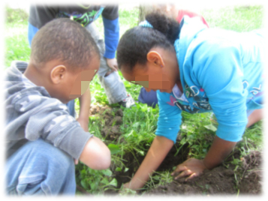
Vignette
Students created soil profile models to identify and explain patterns in the soil horizons from three different locations.
Notes:
During the 6 week investigation, the students in the vignette engaged in many science and engineering practices. Building a comprehensive understanding of when it means to do science and an understanding of the disciplinary core idea.

Slide 35
Notes:
The example from the Vignette shows the blending of the dimensions with CCSS.

Slide 36
Vignette
Disciplinary Core Idea
ESS2.B: Plate Tectonics and Large Scale System Interaction
Maps show where things are located. One can map the shapes and kinds of land and water in any area.

Slide 37
Vignette
Science and Engineering Practice
Developing and Using Models
Develop a model to represent patterns in the natural world.
Notes:
The goal of good science learning includes a lot of practices. Several are highlighted in the vignette

Slide 38
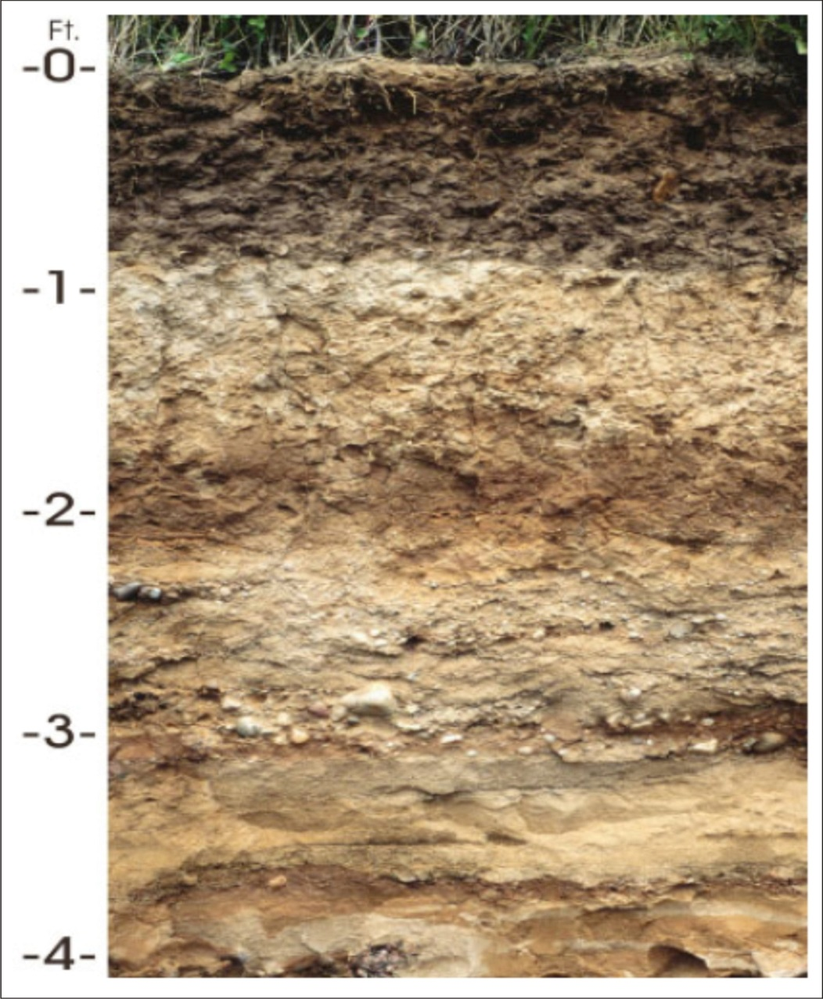
Vignette
Crosscutting Concept – Patterns
  Patterns in the natural world can be
  observed.

Slide 39
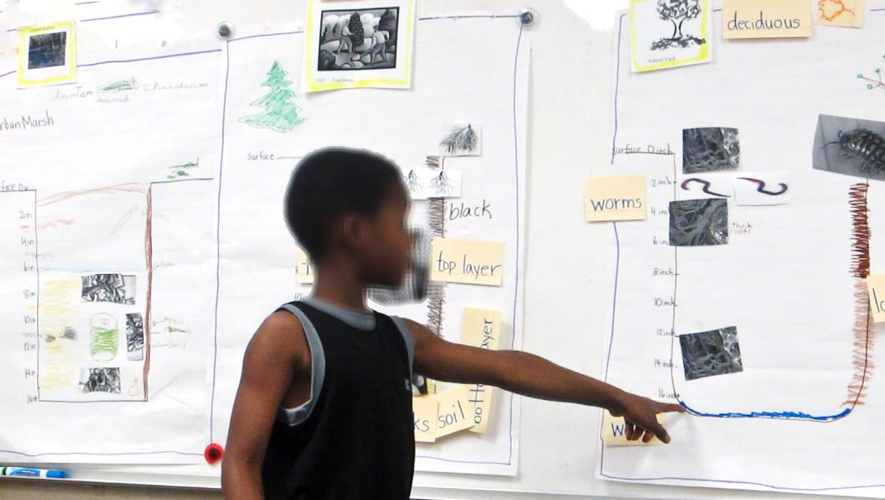
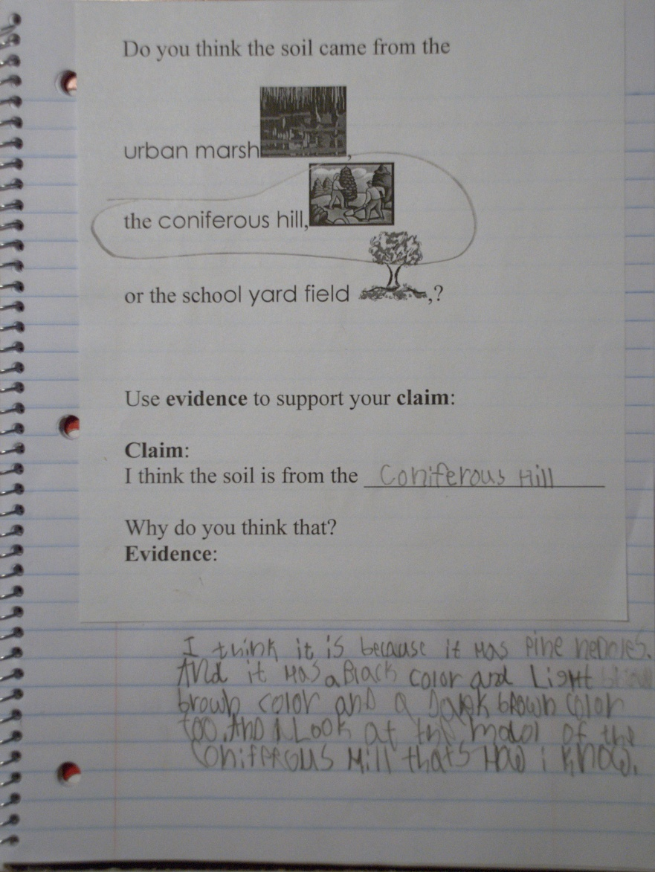
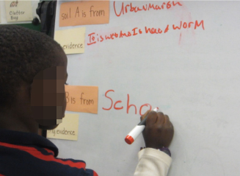

Slide 40
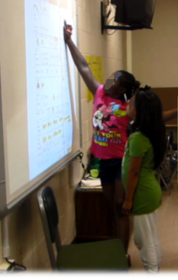
Vignette
CCSS Connections
ELA – Participate in collaborative conversations to explain patterns using pictures and words.
Math – Measure and estimate lengths in standard units both in the field and on the model.
Notes:
NGSS supports an interdisciplinary approach to science learning in order to provide experiences across disciplines. It is for this reason that each science standard explains its connections to CCSS for ELA and math.
The students in the vignette grappled with core ideas in physical science while meeting CCSS for ELA by discussing, writing and revising explanations and evaluating the scientific arguments presented by others.
Students had reading assignments throughout the unit: pressure and how pressure differential are established.
Students synthesized information from the video of the tanker, their experiments, and the gas pressure vs. temperature simulation.
With the help of the teacher, the students wrote arguments about their models and their learning.
The unit also addressed grade appropriate CCSS for math throughout the exploration with core ideas in physical science. In the vignette the students strove to successfully combine math and science practices to present valid explanations.
Math Practice 2 Reason abstractly and quantitatively.
In the vignette, student models reflected abstract reasoning, using a symbol system including comparisons of relative pressure.
SP Investigate patterns of association in bivariate data.
Students drew the conclusion that as one variable (temperature) increased, the other variable (pressure) increased.
S.IC Make inferences and justify conclusions from sample surveys, experiments, and observational studies.
Students inferred the properties of matter from their observations and experiments and justified their conclusions using the models they created.
We lend the way with the vignette for CCSS practices.
Resolve the science is missed in elementary with CCSS

Slide 41
Classroom Strategies
Demographic | Student Engagement | Academic Support Strategies | Home Community Connections
English Language Learners | Discourse strategies | Language and literacy support | Home culture connections; Home language support

Slide 42
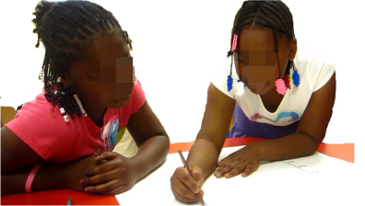
Classroom Strategies
Literacy Support Strategy
authentic dialogue
sentence frames
picture cards
realia
Notes:
to make language accessible and support English language development in literacy.
The students engaged in authentic dialogue using sentence frames,
picture cards and
realia,
to identify patterns in the layers of soil.

Slide 43
Context
Demographics
Science Achievement
Educational Policy
Notes:
To engage all students in learning the NGSS, it is important to understand the context that influences science learning by diverse student groups. This section briefly describes student demographics, science achievement, and educational policies affecting non-dominant student groups. More details are presented in each of the seven case studies in terms of economically disadvantaged students, racial or ethnic minority students, students with disabilities, English language learners, girls, students in alternative education programs, and gifted and talented students.

Slide 44

Demographics
1 in 5 students (21%) speak a language other than English at home
ELL students have more than
doubled in the past decade
      National Center for Education Statistics. (2011).
      The condition of education 2011 (NCES 2011-033). Washington, DC: U.S. Department of Education.
Notes:
Today, over 1 in 5 students (21%) speak a language other than English at home
Limited English Proficient (LEP) students (the federal term) have more than doubled from 5% in 1993 to 11% in 2007

Slide 45

Science Achievement Gaps
National Assessment of Educational Progress (NAEP) in Science
  4th grade
  8th grade
  12th grade
              National Center for Education Statistics. (2011). The nation’s report card: Science 2009. Washington, DC: U.S. Department of Education.

Slide 46

Science Achievement Gaps

Slide 47
Educational Policy – Title 3 Part A
English Language Acquisition, Language Enhancement and Academic Achievement Act
Adequate Yearly Progress (AYP) in English language proficiency and content areas
Increased accountability of English language learners in content-based academics
Funding according to each school’s ability to meet AYP

Slide 48
Educational Policy – Title 3 Part A
Requirements for states:
Implement English language proficiency tests based on English language proficiency standards
Link to the state’s academic standards
Establish proficiency levels (usually ranging from limited proficiency to proficient)

Slide 49

Career and College Ready

