Slide 1
Next Generation Science Standards
Adoption and Implementation Workbook
Notes:
----- Meeting Notes (6/3/13 10:46) -----
Several important things here-
1. Mobius strip - math concept used to show realtionship of the 3 dimensions of NGSS
2. "For states, by states" - not a federal effort, group effort
3. Colors coordinate with DCI's, S&E practices, and CCC
4. "Workbook" meant to be written in, used to do work

Slide 2
Now, more than ever, adoption and implementation are closely intertwined
Challenges of implementation
Implications for adoption
The shifts that the standards will require in the classroom
The scale and complexity at which the shifts must take place
Equipping and motivating thousands of educators to change their day-to-day practices
Ensuring coherence with existing efforts to implement the Common Core State Standards or other College and Career Ready standards in ELA and Math
Before they support adoption, policy-makers, educators, stakeholders, and the public will want a clear sense that your system will be able to meet these challenges
In particular, they will need to understand your plans and timeline for adoption and implementation, before implementation even begins
Notes:
----- Meeting Notes (6/3/13 10:46) -----
Orientation shift to think about challenges of implemenation as one approaches adoption. What are we trying to accomplish, with both adoption and implementation?

Slide 3
The basics
http://www.achieve.org/publications/ngss-adoption-and-implementation-workbook
Developed by Achieve and EDI
Set of tools to assist state and local leaders
Meant to be made your own
Pushes hard on aspirations, ‘the big picture’
Notes:
----- Meeting Notes (6/3/13 10:46) -----
1. url - 25 copies here
2. EDI = Education Delivery Institute; but we refer to it as the NGSS Adoption and Implementation Workbook
3. Some tools, many tools, probably not all tools
4. Individualize as needed while maintaining fidelity
5. Strategic but must know where you are going before you decide how to get there

Slide 4
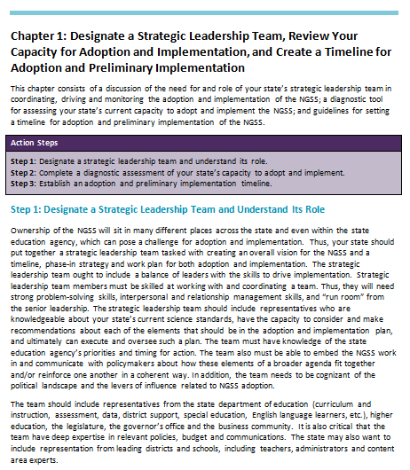
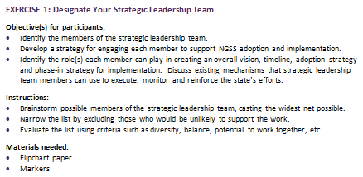
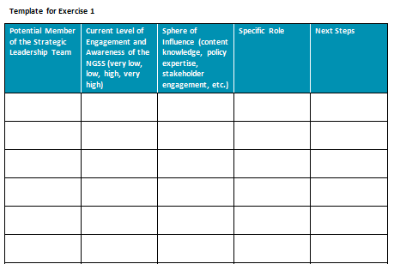
The tool contains guidance, exercises, and templates for teams to use as they work through each step
Notes:
----- Meeting Notes (6/3/13 10:46) -----
narrative explanations, discrete steps and exercises, and templates to help with the work

Slide 5
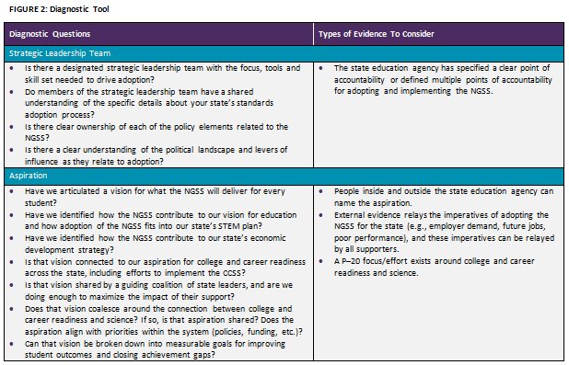
It also includes a diagnostic tool to help you assess your own readiness to implement each step
The diagnostic questions are available in the workbook on pages 13-16
Notes:
----- Meeting Notes (6/3/13 10:46) -----
largely diagnostic and formative

Slide 6
4 or 5 Important Points
PDF and Word versions available for free
Not meant to be linear
7 chapters with 2-4 exercises each
Glossary of Workbook Terms
Diagnostic and formative purposes
Notes:
----- Meeting Notes (6/3/13 10:46) -----
1. Word version so you can work in it right at your site or customize it for particular audiences
2. a toolbox with a logical organization; not a step by step set of directions
3. lots of tools
4. glossary important for working with diverse audiences
5.

Slide 7
Adoption AND Implementation Workbook
Team based – don’t try this alone
Chapter 1 on Strategic Leadership Team formation
Chapter 2 on Defining Your Aspiration

Slide 8
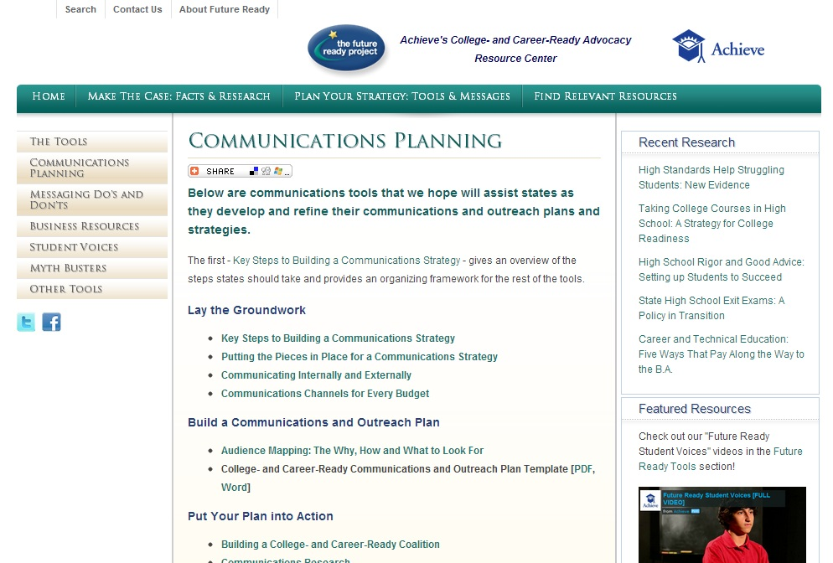
A Goal Without A Plan Is Just A Wish
http://www.futurereadyproject.org/communications-planning
Notes:
Communications Planning
Below are communications tools that we hope will assist states as they develop and refine their communications and outreach plans and strategies.
The first - Key Steps to Building a Communications Strategy - gives an overview of the steps states should take and provides an organizing framework for the rest of the tools.
Lay the Groundwork
Key Steps to Building a Communications Strategy
Putting the Pieces in Place for a Communications Strategy
Communicating Internally and Externally
Communications Channels for Every Budget
Build a Communications and Outreach Plan
Audience Mapping: The Why, How and What to Look For
College- and Career-Ready Communications and Outreach Plan Template [PDF, Word]
Put Your Plan into Action
Building a College- and Career-Ready Coalition
Communications Research
Hosting a College- and Career-Ready Roundtable
Talking to the Media 101
Engaging the Media
Measuring a Communications Strategy's Success
A Mid-Course Audit for Your College- and Career-Ready Communications Strategy
----- Meeting Notes (6/3/13 10:46) -----
Good slogan; good additional resoruce

Slide 9
We have developed a tool for helping state teams to think through the critical steps for adoption and implementation of the NGSS
Designate a strategic leadership team,
Review capacity, and
Create a preliminary timeline
Define your aspiration
Evaluate past and present performance
Determine the state’s role and approach to implementation
Set targets and trajectories
Develop a stakeholder engagement strategy
Establish routines and solve problems
Notes:
----- Meeting Notes (6/3/13 10:48) -----
The seven chapters

Slide 10
Let’s dig in—Chapter 1, Step 2
Please open your books to page 13;
Figure 2: Diagnostic Tool

Slide 11
To complete this exercise, you’ll use the diagnostic tool in your workbook
The diagnostic questions are available in the workbook on pages 13-16
Notes:
----- Meeting Notes (6/3/13 10:57) -----
This tool consists of a table of diagnostic questions on the seven chapters/major topics and the TYPE OF EVIDENCE TO ADDRESS THE QUESTION-
Strategic leadership team
Apiration
Past and Present Performance
State's Role and Approach
Targets and Trajectories
Stakeholder Engagement Strategy
Routines for Monitoring Progress
Let's look at Aspiration (7 diagnostic questions) - is the evidence appropriate, collected, and used? What other evidence might you gather?

Slide 12
EXERCISE 2 – Review Capacity to Adopt and Implement the NGSS – page 17
Instructions:
Read through the diagnostic tool and take notes individually on evidence of strength or challenge for each critical element.
Determine who has access to/holds the evidence.
Use the evidence to arrive at an individual rating for each critical element.
Share individual ratings (weak = 1 to strong = 4) with the group by marking on the flipchart.
Discuss and come to consensus as a group on areas of relative strength and challenge across the critical elements.
Exercise notes:
Guiding questions for discussion.
You may not need to bring the group to consensus; the discussion and agreement on evidence is more important than any specific rating.

Slide 13
Important Reminders!!
1. There is no right answer.
2. There is no sample plan.
3. Evidence is critical.
4. You are building a knowledge base.
5. This is of value to LEAs as well as SEAs.

Slide 14
Let’s dig in again —Chapter 4, step 1
Please open your books to page 47, then to page 50 Exercise 9: Define Your State’s Role
(in relation to 5 levers of:
Policy/Guidance
Funding
Capacity-building
Monitoring
Coordination)

Slide 15
EXERCISE 9 – Define Your State’s Role– page 50
Instructions:
Using the template, answer questions for each of the five levers under “Current Use” columns for the CCSS (building on what we have learned from CCSS implementation) and past science standards implementation
How has this lever…
What has it looked like…successful…
What has it looked like…unsuccessful…
Using the template, answer questions for each of the five levers under “Future Use: NGSS Implementation”:
How important…
What will we do similarly…
What will we do differently…

Slide 16
Critical Audiences
State Board of Education Members
Teachers
Department or Curriculum Leads
School Leaders
Governor’s Office
Legislators & Staff
SEA leaders & Staff
Higher Education Officials
State Science Supervisors
District Leaders
District Science Supervisors
Business leaders & Chambers
STEM Organizations & Networks
Workforce Development Organizations & Agencies
Philanthropic Organizations
School Board Members & Associations
Parents & PTAs
Advocacy Organizations
Civil Rights Organizations
Scientific Community
Teacher Unions and Associations
Regional Service Centers
KIDS!!!

Slide 17
Your turn
Who in here has used this Workbook and how?
What more do you need?
Webinars on specific topics – which ones?
Missing tools – on/for what?

Slide 18
Takeaways
1. Make this your own
2. Push hard on describing your aspiration and how you would measure that
3. Feedback, feedback, feedback
Have a rationale for what you are doing, based on state data if at all possible
Resources abound – maybe not cash but when have we ever had that?

Slide 19
Contact
Tom Keller
Senior Adviser, Science
tkeller@achieve.org
www.nextgenscience.org

